Slide 1
SECURE DATA HIDING IN IMAGES USING STEGANOGRAPHY
EDUNET PROJECT
Presented By:
SATHVIK A R
SIR M. VISVESVARAYA INSTITUTE OF TECHNOLOGY
Department of IOT & Cybersecurity including Blockchain Technology

Slide 2
OUTLINE
Problem Statement
Technology used
Wow factor
End users
Result
Conclusion
Git-hub Link
Future scope

Slide 3
Problem Statement
In the digital era, data security and privacy have become critical concerns. Traditional encryption methods can secure messages, but their presence is often detectable, raising suspicion.
Steganography provides an alternative by concealing information within digital media, making the hidden message undetectable to unintended users.
This project focuses on image steganography, where a secret message is embedded into an image without visibly altering its appearance. The challenge lies in securely hiding and retrieving messages while ensuring minimal distortion to the image. Additionally, unauthorized access should be prevented using a password-based decryption system.
The objective of this project is to develop a user-friendly GUI-based tool using Python, OpenCV, and Tkinter that allows users to encrypt and decrypt messages within images. The tool should ensure secure message embedding, prevent unauthorized access, and provide an easy-to-use interface for non-technical users. By implementing this solution, users can communicate securely without raising suspicion, making it useful for confidential data transmission, watermarking, and secure document storage.

Slide 4
Technology used
1️⃣ Python – Python is the core programming language used for this project due to its simplicity and extensive libraries for image processing and GUI development.
2️⃣ OpenCV (cv2) – OpenCV is a powerful image processing library that allows reading, modifying, and saving images. It is used to embed the secret message within the pixel values of an image and later retrieve it during decryption.
3️⃣ Tkinter – Tkinter is Python’s built-in library for creating graphical user interfaces (GUI). It is used to design an interactive interface where users can select images, input messages and passwords, and trigger encryption or decryption functions with buttons.
4️⃣ PIL (Pillow) – The Python Imaging Library (PIL), now maintained as Pillow, is used to handle images within the GUI. It helps in loading, displaying, and resizing images to make them user-friendly in the interface.
5️⃣ OS Module – The os module is used to open the encrypted image automatically after saving, enhancing user experience.
Together, these technologies create an efficient steganography tool, combining image processing, security, and a user-friendly GUI for seamless data hiding and retrieval.

Slide 5
Wow factors
✅ Invisible Data Hiding – Unlike traditional encryption, which makes data security obvious, this tool hides messages within images without altering their appearance, making it stealthy and undetectable.
✅ User-Friendly GUI – The project features a simple and intuitive interface using Tkinter, allowing users to encrypt and decrypt messages with just a few clicks, making it accessible even for non-technical users.
✅ Password-Protected Security – Only users with the correct passcode can retrieve the hidden message, ensuring that confidential data remains secure.
✅ Minimal Image Distortion – The message is embedded in pixel values without significantly altering the image quality, making the changes imperceptible to the human eye.
✅ Cross-Platform Compatibility – Built with Python, the tool can run on Windows, macOS, and Linux, making it versatile and widely accessible.
✅ Practical Real-World Applications – This project can be used for secure communication, watermarking, digital signatures, and confidential data storage, making it more than just a simple coding project!
With these wow factors, the project stands out as a powerful, secure, and innovative steganography tool for hidden message transmission!

Slide 6
End users
The Image Steganography Tool is designed for individuals and organizations that need to securely transmit or store sensitive information without drawing attention. The key end users include:
🔹 Cybersecurity Professionals – Experts who need to hide confidential data in images for secure communication.
🔹 Journalists & Activists – People working in sensitive environments can use this tool to safely exchange information without detection.
🔹 Military & Intelligence Agencies – Steganography can be used for covert communication in high-security operations.
🔹 Researchers & Academics – Used in digital forensics and cryptography studies to explore data hiding techniques.
🔹 Artists & Photographers – Can embed watermarks or hidden signatures into images to prevent plagiarism or claim ownership.
🔹 Businesses & Enterprises – Companies can secure trade secrets, contracts, or internal documents within images to prevent unauthorized access.
🔹 General Users – Anyone who wants to privately store or share sensitive messages without traditional encryption methods.
This project has a wide range of applications, making it useful for privacy-conscious individuals and organizations that require covert and secure data transmission.

Slide 7
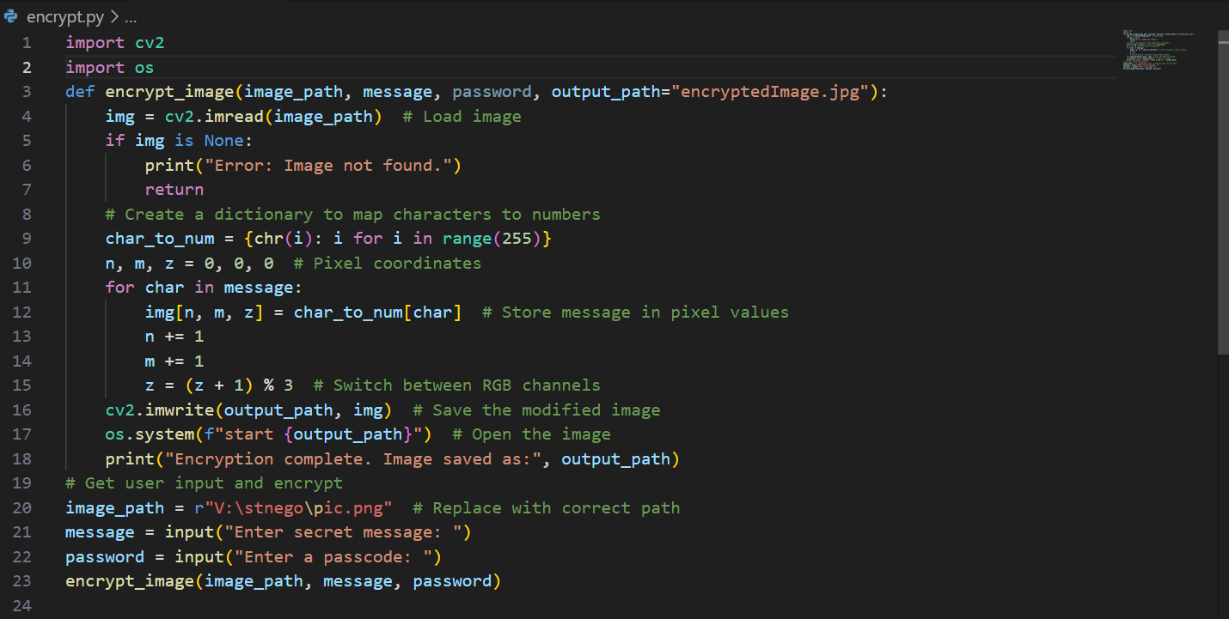
Results
Encryption Code

Slide 8
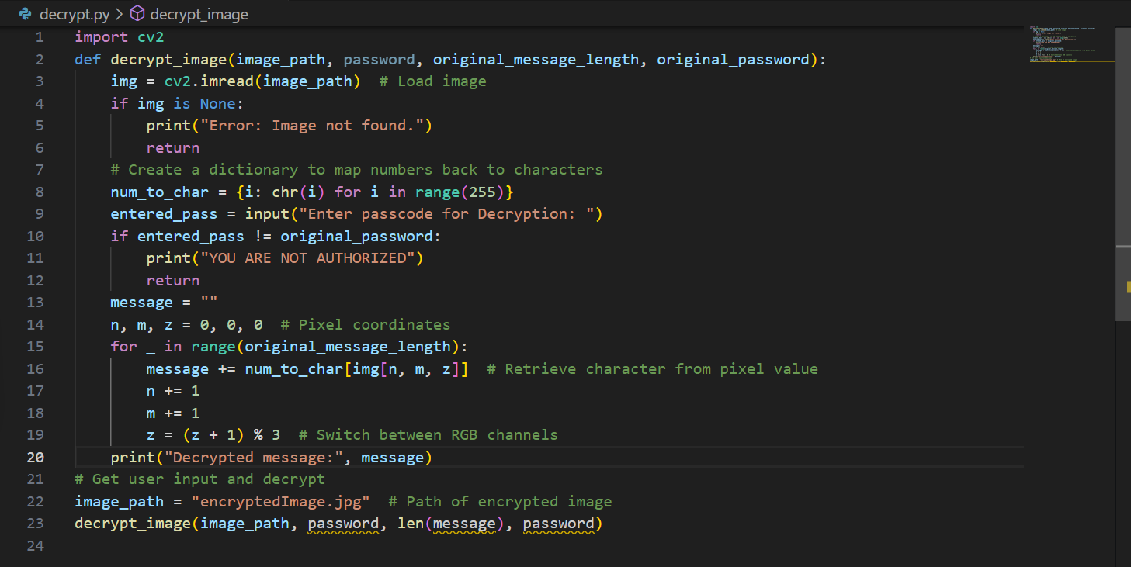
Results
Decryption Code

Slide 9
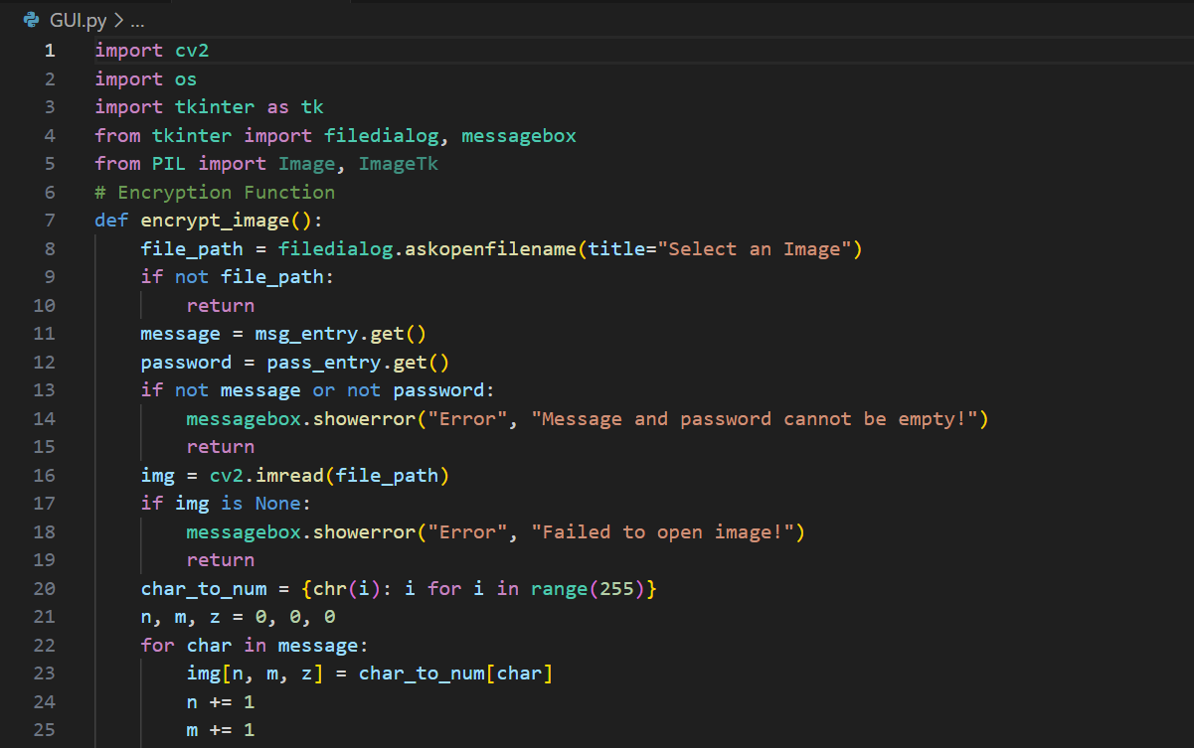
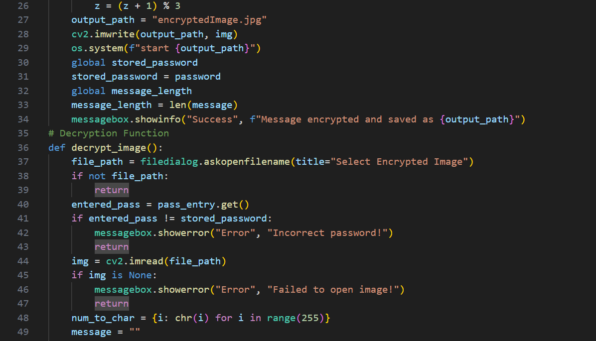
RESULTS
GUI CODE

Slide 10
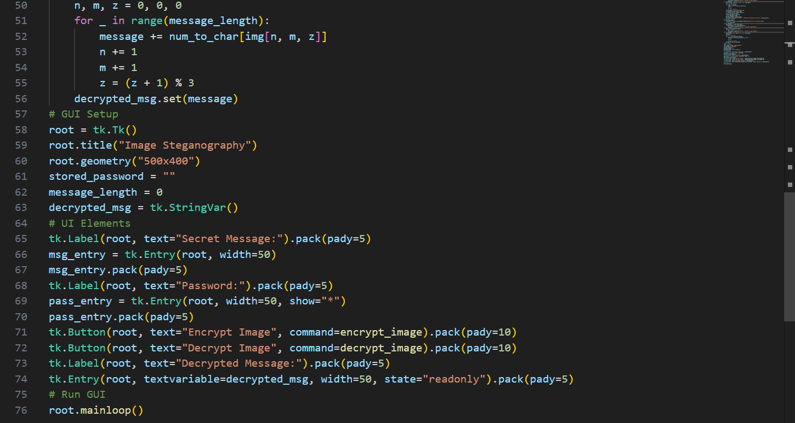
RESULTS
GUI CODE

Slide 11
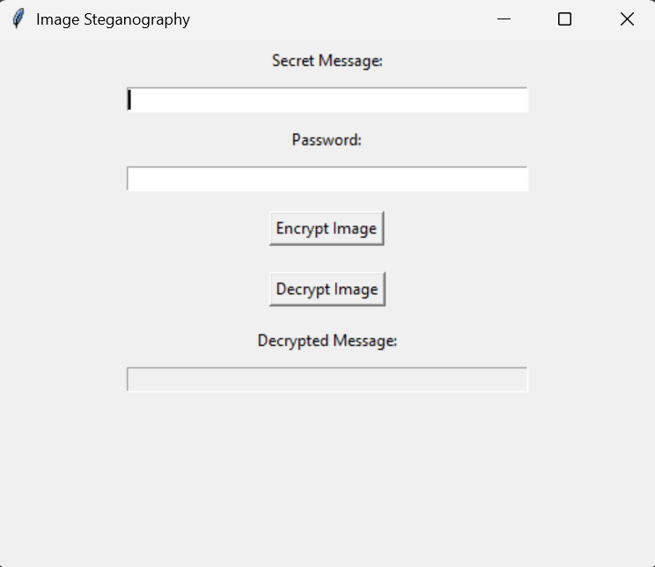
RESULTS
GUI INTERFACE

Slide 12
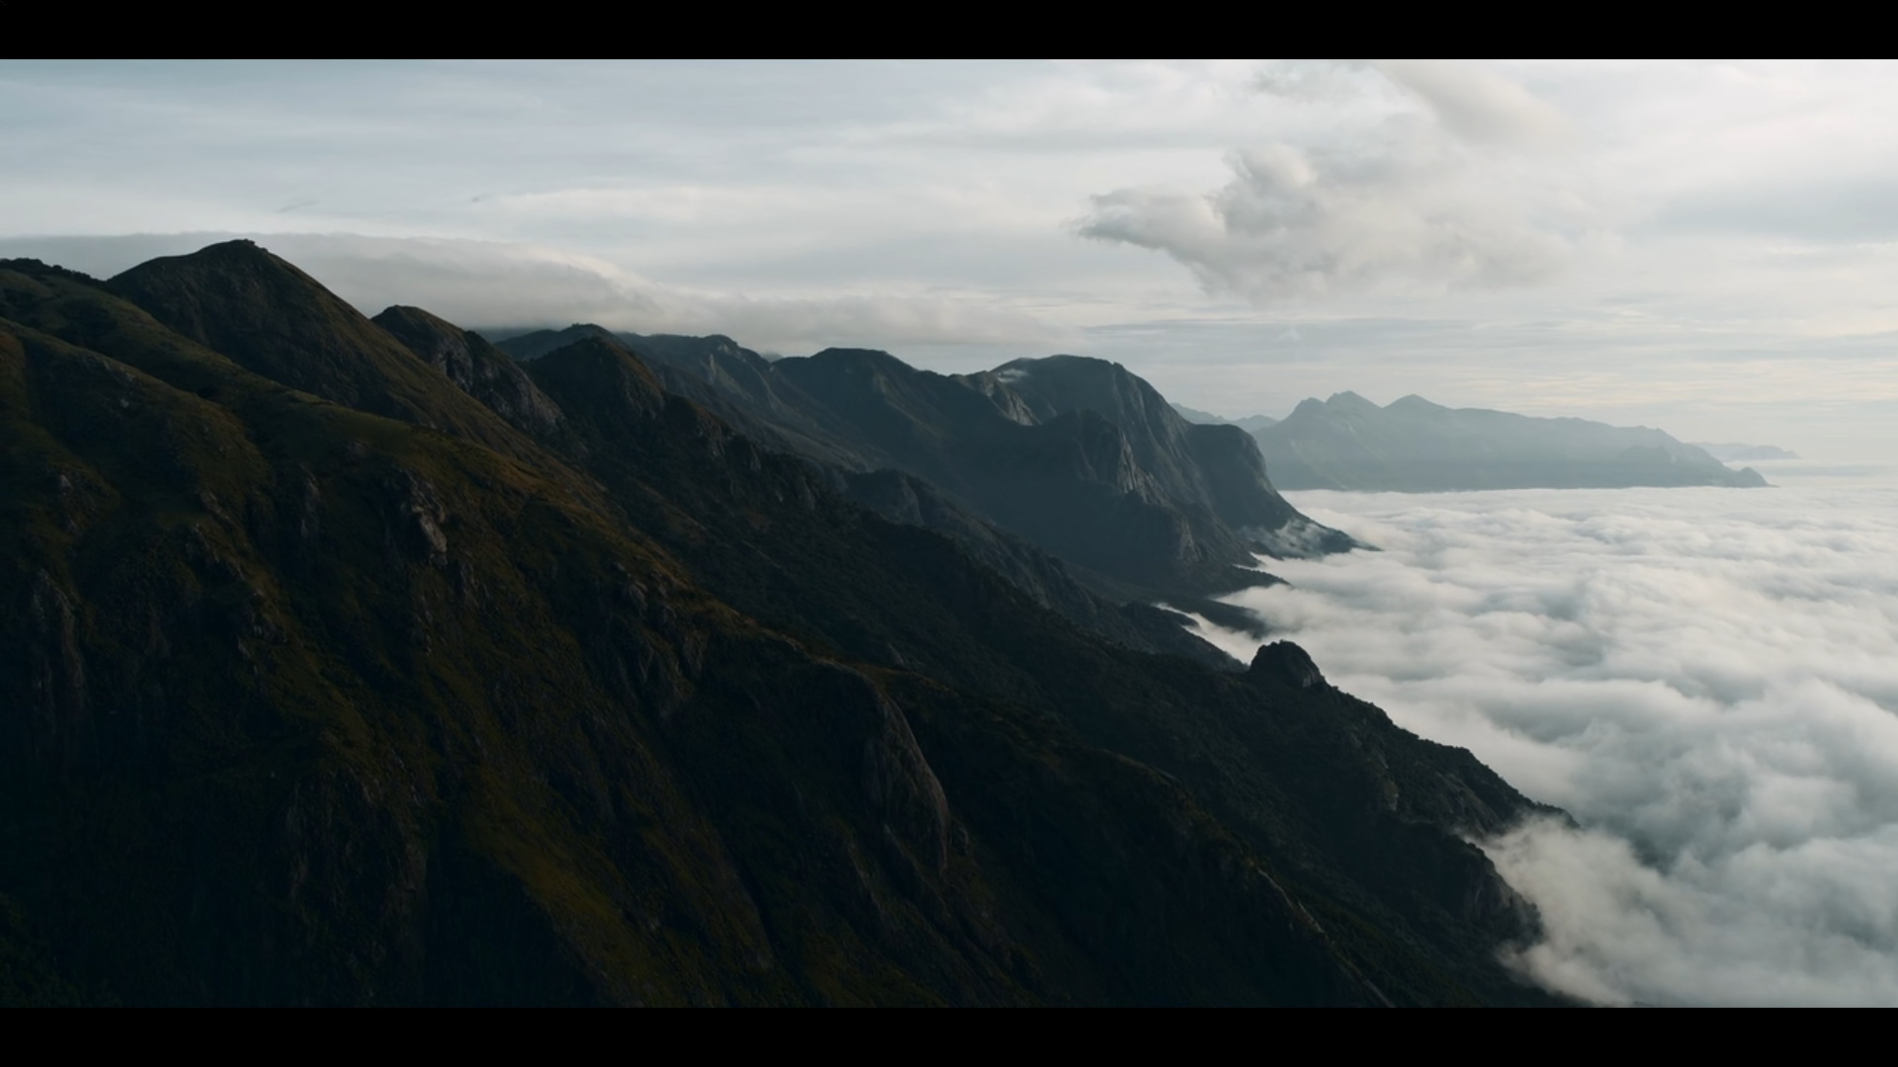
RESULTS
ENCRYPTED IMAGE

Slide 13
Conclusion
The Image Steganography Tool successfully provides a secure and user-friendly method for hiding and retrieving secret messages within images. By leveraging Python, OpenCV, and Tkinter, the project ensures invisible data embedding, password protection, and minimal image distortion, making it an effective alternative to traditional encryption methods.
This tool has wide applications in cybersecurity, digital forensics, journalism, military communication, and intellectual property protection. Its stealthy approach to data security allows confidential information to be transmitted or stored without raising suspicion.
Overall, this project demonstrates the power of steganography in modern digital security, offering a practical, efficient, and innovative way to safeguard sensitive information. Future enhancements, such as stronger encryption techniques and support for larger messages, can further enhance its capabilities for real-world applications.

Slide 14
GitHub Link
https://github.com/sathvikradhikam/Stegnography

Slide 15
Future scope
The Image Steganography Tool has significant potential for further enhancements and real-world applications. Some key future developments include:
🔹 Advanced Encryption Techniques – Integrating cryptographic algorithms (AES, RSA) before embedding messages will enhance security.
🔹 Support for Larger Messages – Optimizing data encoding methods can allow storing longer messages without significantly affecting image quality.
🔹 Multi-Level Security – Adding multi-layer password protection or biometric authentication (fingerprint/face recognition) can increase security.
🔹 Steganography in Other Media – Expanding the project to support audio and video files for hidden data transmission in different formats.
🔹 AI-Based Steganalysis Detection – Implementing machine learning models to analyze images and detect hidden messages, improving steganography research.
🔹 Mobile & Web Application – Developing a cross-platform mobile app or web tool to make steganography accessible on smartphones and browsers.
🔹 Cloud Integration – Enabling secure cloud-based steganography services where users can upload, encrypt, and share hidden messages online.
With these advancements, this project can evolve into a powerful and widely used tool for secure communication, data protection, and digital privacy in the future.

Slide 16
THANK YOU

